Slide 1
Cloud Computing
SEWP ZG527

Slide 2
Agenda
Virtualization Techniques and Types
Introduction to Virtualization
Use & demerits of Virtualization
Types of Virtualization
- Examples
x86 Hardware Virtualization
2

Slide 3
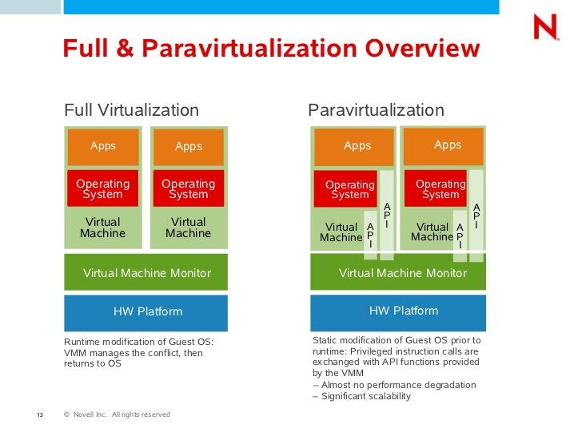
Approaches for Virtualization
Notes:
RL 2.3

Slide 4
Full Virtualization
Full virtualization
In its basic form known as “full virtualization” the hypervisor provides a fully emulated machine in which an operating system can run. VMWare is a good example.
The biggest advantage to this approach is its flexibility: one could run a RISC-based OS as a guest on an Intel-based host.
While this is an obvious approach, there are significant performance problems in trying to emulate a complete set of hardware in software.

Slide 5
ParaVirtualization
Paravirtualization
“Paravirtualization,” found in the XenSource, open source Xen product, attempts to reconcile these two approaches. Instead of emulating hardware, paravirtualization uses slightly altered versions of the operating system which allows access to the hardware resources directly as managed by the hypervisor.
This is known as hardware-assisted virtualization, and improves performance significantly.
In order to retain flexibility, the guest OS is not tied to its host OS. Drastically different operating systems can be running in a hypervisor at the same time, just as they can under full virtualization.
In this way, paravirtualization can be thought of as a low-overhead full virtualization

Slide 6
SKI Virtualization
Single Kernel Image (SKI),
Single Kernel Image (SKI), in which the host OS spawns additional copies of itself. This kind of virtualization can be found in Swsoft Virtuozzo and Sun Solaris, Zones. SKI can be thought of as “lightweight” virtualization.
While this approach avoids the performance problems with pure emulation, it does so at the expense of flexibility.
It is not possible, for instance, to run different versions or even different patch levels of a particular operating system on the same machine.
Whatever versions exist in the host, that same software will be provided in the guest. SKI also sacrifices the security and reliability provided by other virtualization methods.

Slide 7
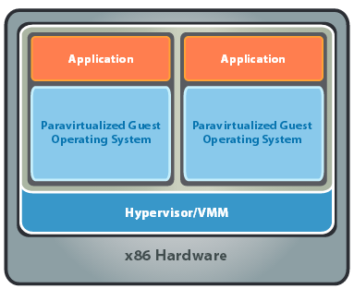
x86 Hardware Virtualization
The latest generation of x86-based systems feature processors with 64-bit extensions supporting very large memory capacities.
This enhances their ability to host large, memory-intensive applications, as well as allowing many more virtual machines to be hosted by a physical server deployed within a virtual infra-structure.
The continual decrease in memory costs will further accelerate this trend.

Slide 8
x86 Hardware Virtualization
For Industry-standard x86 systems, the two approaches typically used with software-based partitioning are
hosted and
hypervisor architectures
A hosted approach provides partitioning services on top of a standard operating system and supports the broadest range of hardware configurations.
In contrast, a hypervisor architecture is the layer of software installed on a clean x86-based system (hence it is often referred to as a “bare metal” approach). Since it has direct access to the hardware resources, a hypervisor is more efficient than hosted architectures, enabling greater scalability, robustness and performance

Slide 9
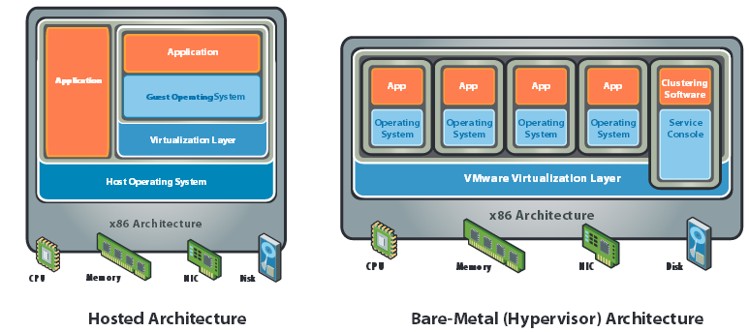
x86 Hardware Virtualization

Slide 10
Terminologies to remember
Basic technique of virtualization is – Trap and Emulate Virtualization
Privilege levels or protection ring
CPL – Current Privilege Level (Guest OS)
Instruction Types – Behavior sensitive, Control sensitive
Control sensitive (privileged instructions)
Method of virtualization – Binary Translation
Para virtualization (Hypervisor dependent)

Slide 11
Advantages of Virtualization
Instant provisioning - fast scalability
Live Migration is possible
Load balancing and consolidation in a Data Center is possible.
Low downtime for maintenance
Virtual hardware supports legacy operating systems efficiently
Security and fault isolation

Slide 12
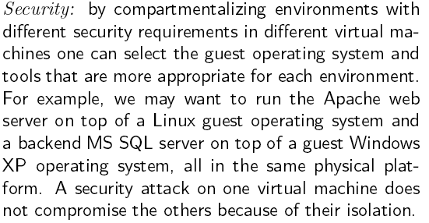
Advantages of Virtualization

Slide 13
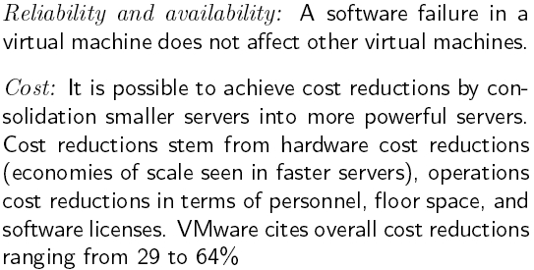
Advantages of Virtualization

Slide 14
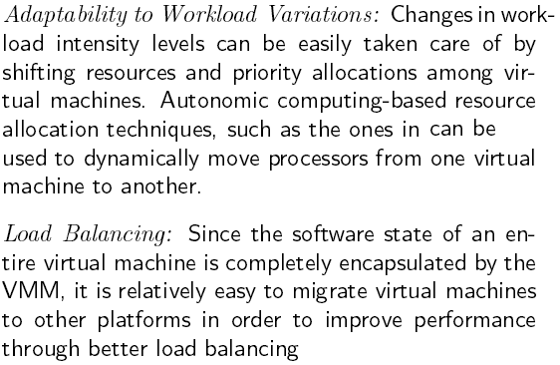
Advantages of Virtualization

Slide 15
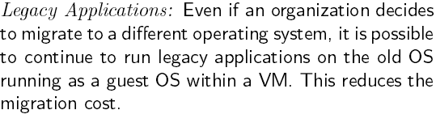
Advantages of Virtualization

Slide 16
Issues to be aware of
Software licensing
One of the most significant virtualization-related issues to be aware of is software licensing. Virtualization makes it easy to create new servers, but each VM requires its own separate software license. Organizations using expensive licensed applications could end up paying large amounts in license fees if they do not control their server sprawl.
IT training
IT staff used to dealing with physical systems will need a certain amount of training in virtualization. Such training is essential to enable the staff to debug and troubleshoot issues in the virtual environment, to secure and manage VMs, and to effectively plan for capacity.
Hardware investment
Server virtualization is most effective when powerful physical machines are used to host several VMs. This means that organizations that have existing not-so-powerful hardware might still need to make upfront investments in acquiring new physical servers to harvest the benefits of virtualization

Slide 17
Issues to be aware of
Performance can be a concern, especially for in-band deployments, where the virtualization controller or appliance can become a bandwidth bottleneck.
Interoperability among vendor products is still evolving.
Failure of the virtualization device, leading to loss of the mapping table.

Slide 18
Applications of Virtualization
Today, virtualization can apply to a range of system layers, including hardware-level virtualization, operating system-level virtualization, and high-level language virtual machines.
Maximize resources — Virtualization can reduce the number of physical systems you need to acquire, and you can get more value out of the servers. Most traditionally built systems are underutilized. Virtualization allows maximum use of the hardware investment.
Multiple systems — With virtualization, you can also run multiple types of applications and even run different OS for those applications on the same physical hardware.
IT budget integration — When you use virtualization, management, administration and all the attendant requirements of managing your own infrastructure remain a direct cost of your IT operation.

Slide 19
Technology Trends
Virtualization is Key to Exploiting Trends
Allows most efficient use of the compute resources
Few apps take advantage of 16+ CPUs and huge memory as well as virtualization
Virtualization layer worries about NUMA, not apps
Maximize performance per watt across all servers
Run VMs on minimal # of servers, shutting off the others
Automated, live migration critical:
Provide performance guarantees for dynamic workloads
Balance load to minimize number of active servers
Stateless, Run-anywhere Capabilities
Shared network and storage allows flexible mappings
Enables additional availability guarantees

Slide 20
Thanks!!!
Queries?

